Slide 1
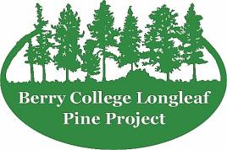
The Berry College Longleaf Pine Project
Restoration of Mountain Longleaf Pine on the World’s Largest College Campus
Martin L. Cipollini, PhD.
Dana Professor of Biology
Berry College

Slide 2
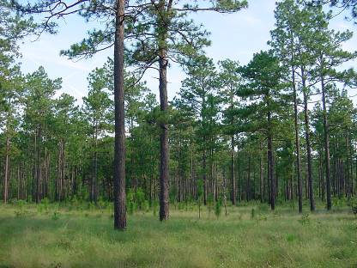
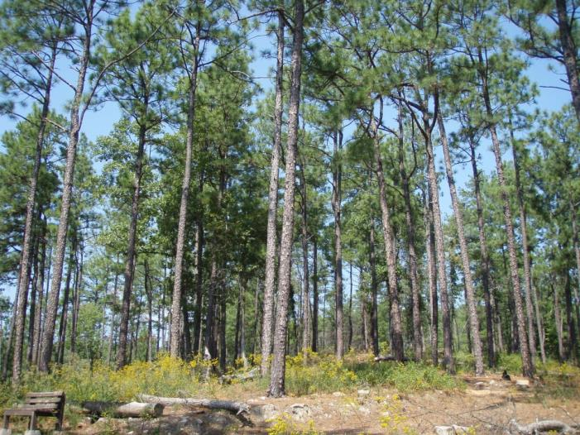
Regional mountains harbor “Montane” Longleaf Pine
Most longleaf is in the
Coastal Plain
Longleaf Pine on Berry’s
Lavender Mountain

Slide 3
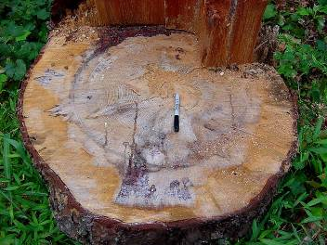
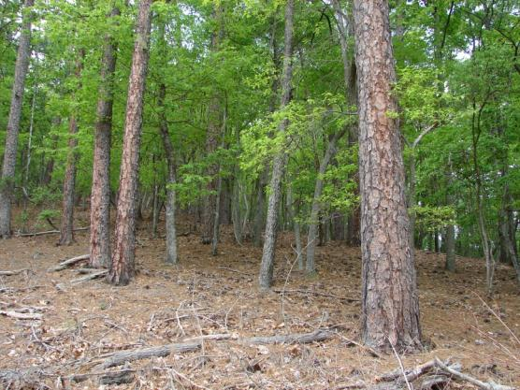
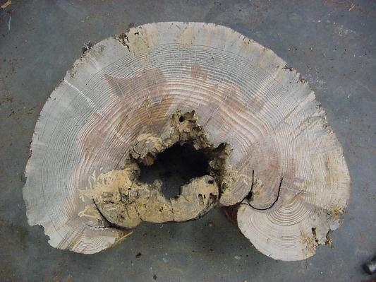
Origins of the Berry College Longleaf Pine Project
1995 Roger Birkhead’s independent study showed trees > 200 years old on Berry College’s Lavender Mountain
1999 Plant Ecology class initiated long-term census work
2001 SAVE club responded to logging with a tree planting event
2002 management plan developed by Karen Vaughn as an extension of a Plant Ecology project

Slide 4
Why develop a management plan?
Longleaf pine is an ICUN Red List Endangered Species, occupying only about 2% of their original 92 million acre range.
Old trees and late 1800’s maps suggested widespread longleaf pine community on Lavender Mountain.
Few new trees since 1920s-1930s – local population was in decline.
Burning had been restricted for 60-70 yrs, resulting in hardwood encroachment, fuel buildup, and near total loss of understory plants.
Most of mountain was never plowed, suggesting that recovery of understory plants might be possible (seed bank).
Southern Pine Beetle (SPB) and wildfires are common problems with loblolly and shortleaf pine forests on campus.
Most importantly, the college campus context gave an excellent opportunity to engage in a variety of service-learning opportunities.

Slide 5
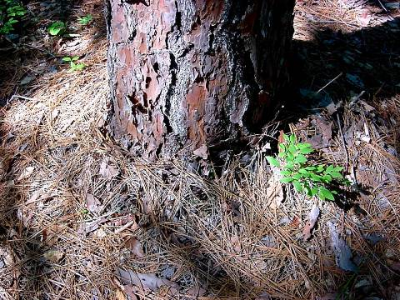
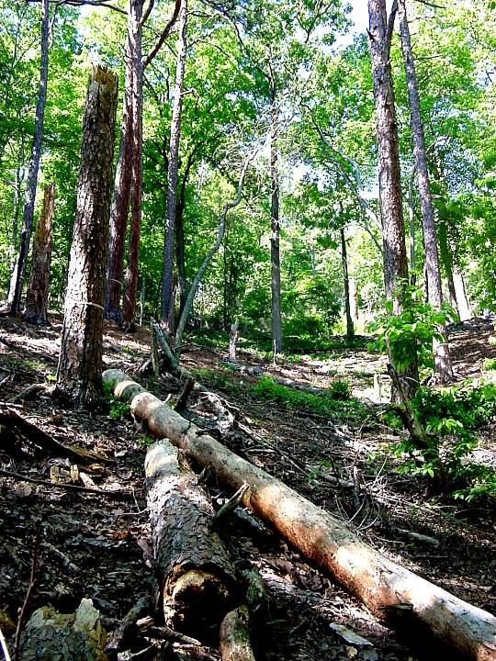
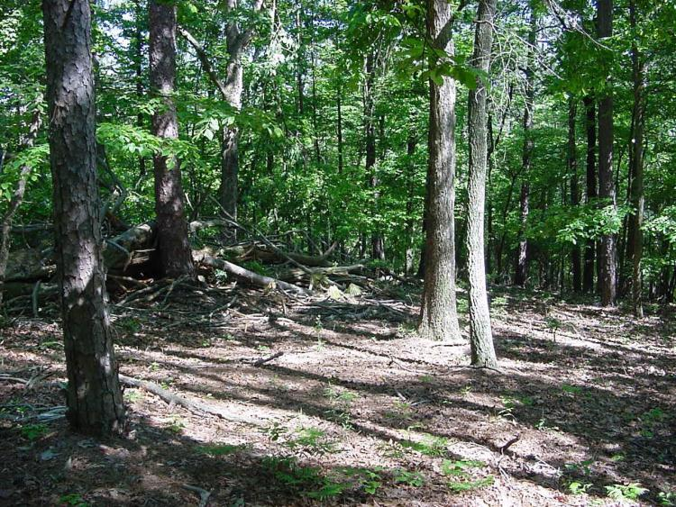

Slide 6
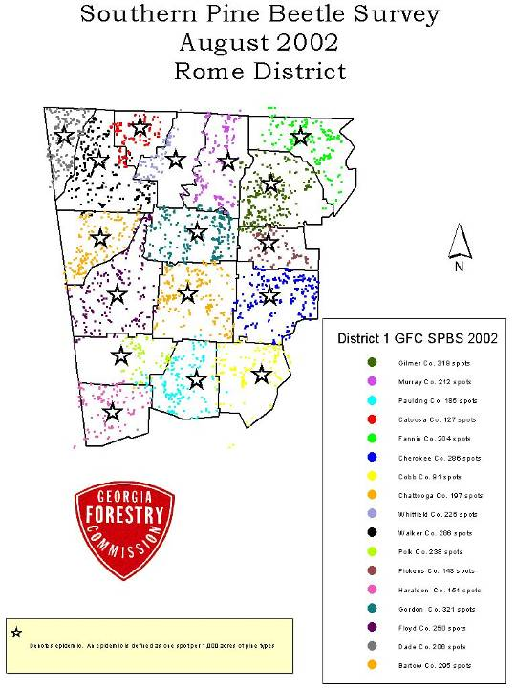
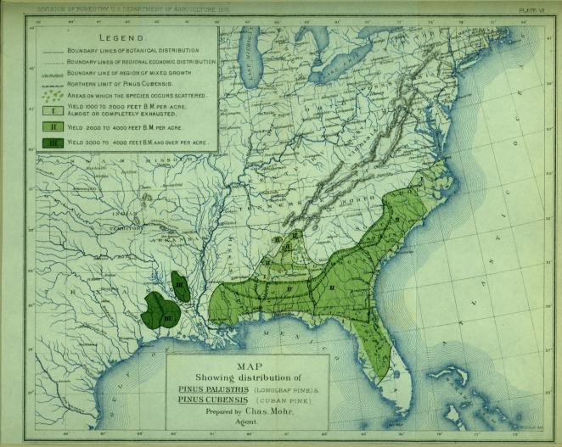
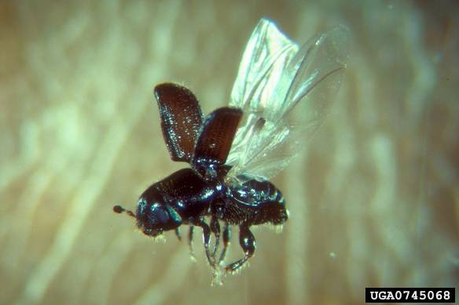

Slide 7
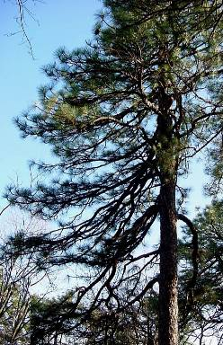
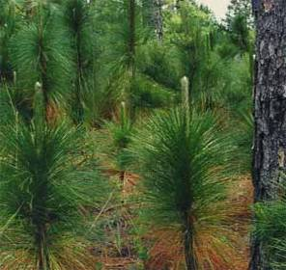
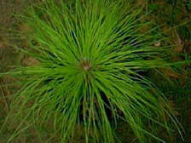
Longleaf Pine Life Cycle
Seeds germinate on bare soil
Remain in “grass” stage for several years
Only grows upward in open conditions
Can live up to 500 years

Slide 8
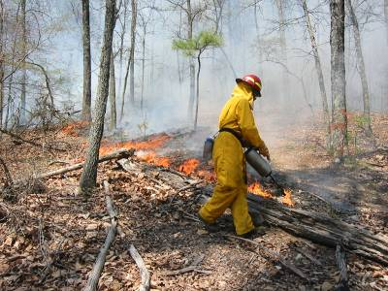
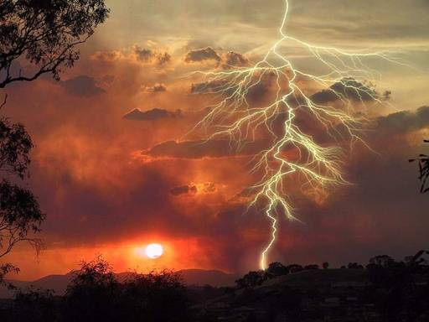
Longleaf Pine is adapted to periodic surface fires
Causes of fire
Lightning strikes
Native Americans and post 1830s settlers
Adaptations
Resistant grass stage
Fast height growth
Thick bark
High sap and needle production

Slide 9
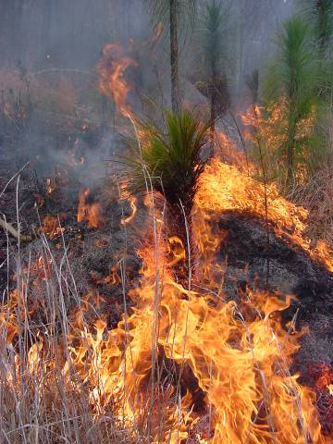
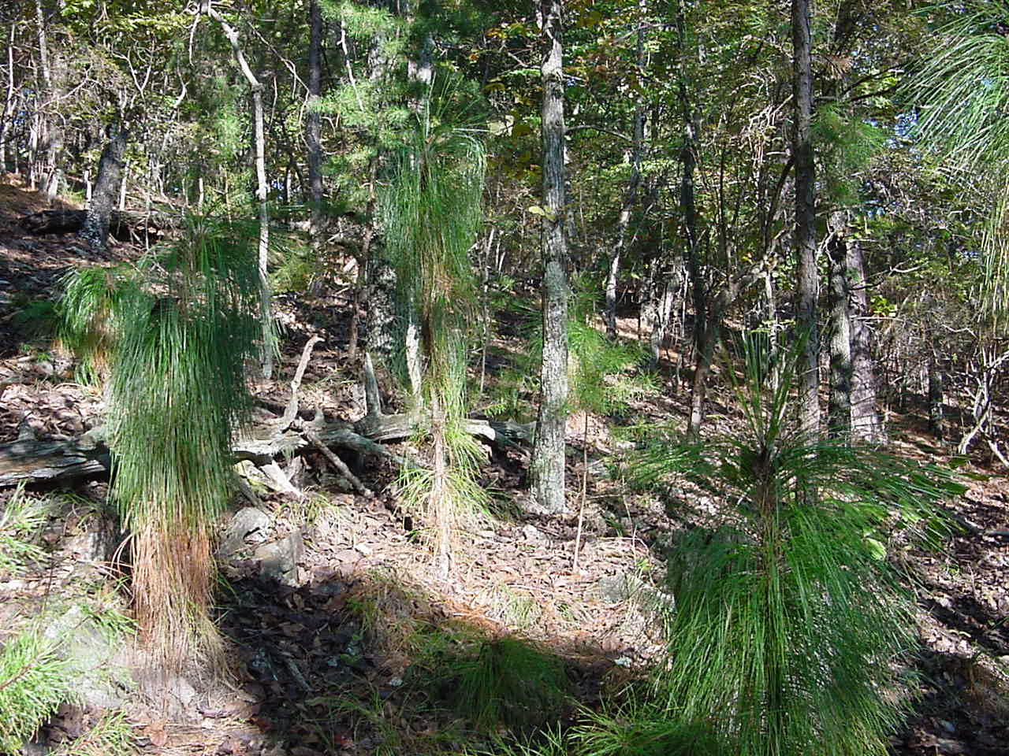
Seedlings and fire
Seeds require bare soil to germinate
Needles protect bud
Fire kills hardwoods and other competitors
Fire protects seedlings from some diseases (e.g., brown leaf spot).

Slide 10
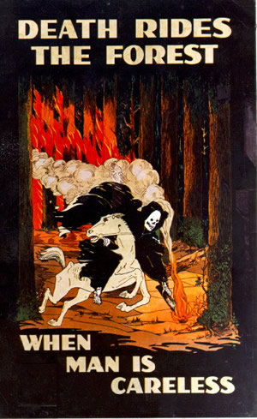
The decline of Longleaf Pine
Fire suppression!
Timber harvesting
Tapping for turpentine
Replacement with faster growing pines like loblolly
Combined factors have contributed to a decline from +/- 90 million acres throughout the south to less than 2% of the original range!
U.S. Forest Service

Slide 11
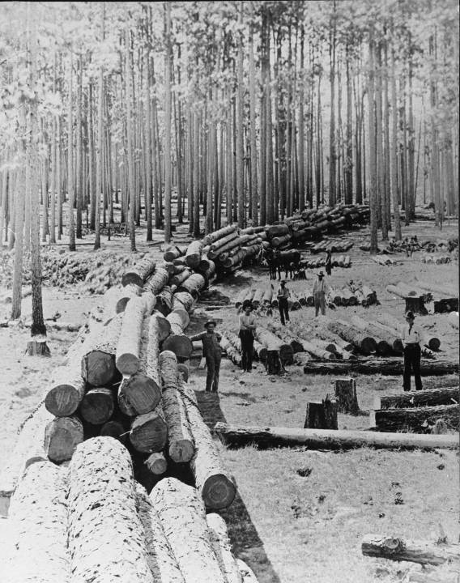
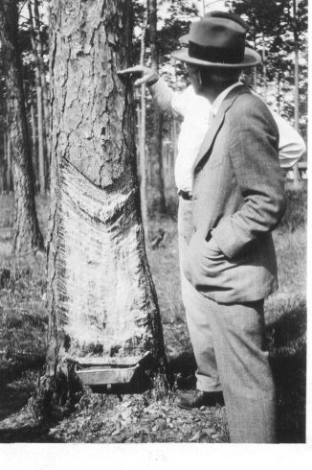
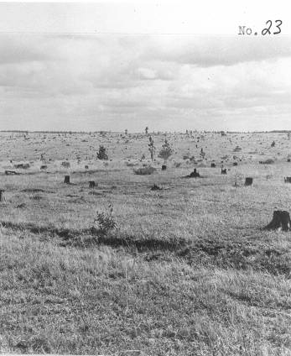

Slide 12
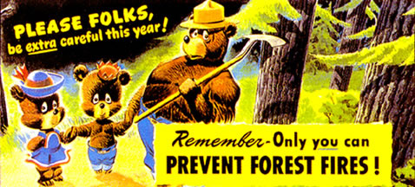
And then came the “Smoky the Bear” campaign…
U.S. Forest Service

Slide 13
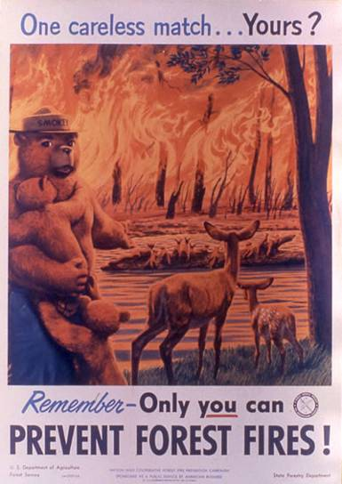
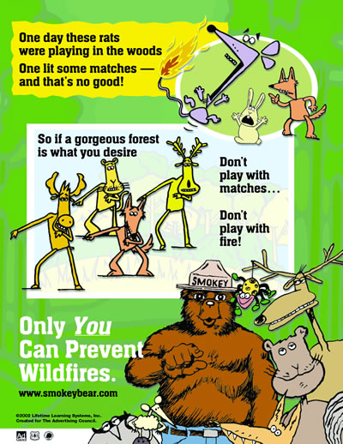
A Changing Message….

Slide 14
Management plan overview
2001 – began planting seedlings
2003 – began restoring burning regime on 3-5 year frequency
2005 – began controlling hardwoods and invasive species via removal and herbicide application
2005 – began establishing local seed sources via cone collection and seed orchard development
Along the way - research, education, and outreach
Help from Berry’s Land Resources, Student Work, Volunteer Services, Berry Longleaf Network, Interagency Burn Team, and various internal and external grants.

Slide 15
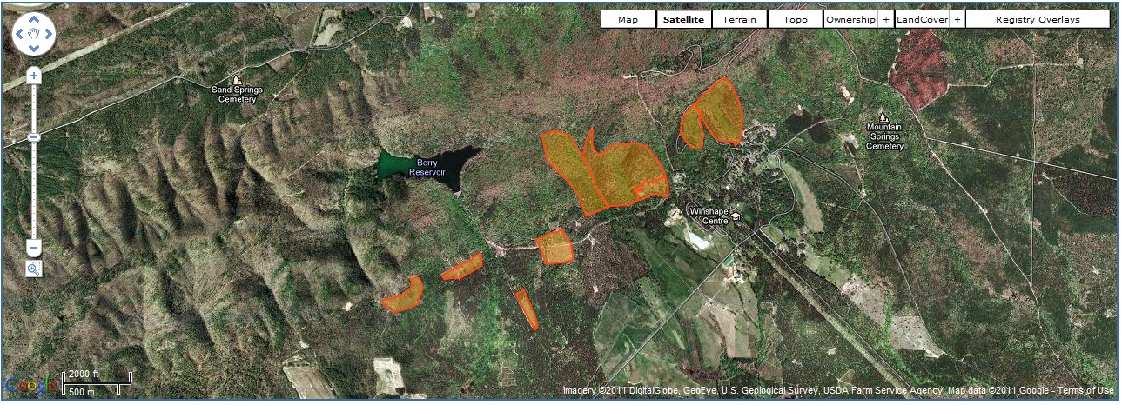
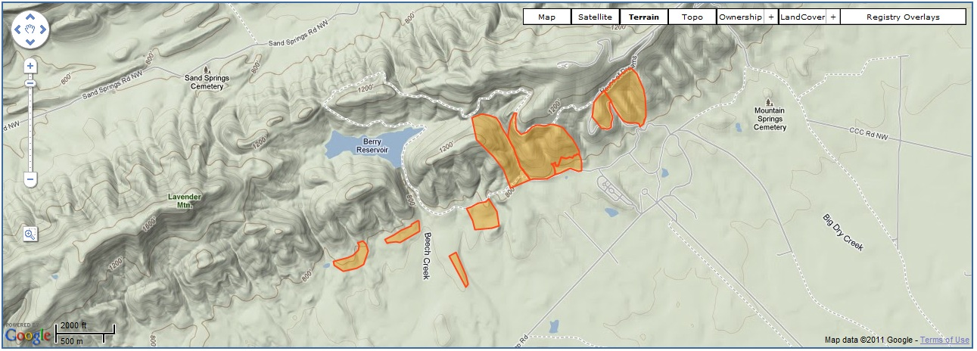
http://nfwf.conservationregistry.org/projects/3810

Slide 16
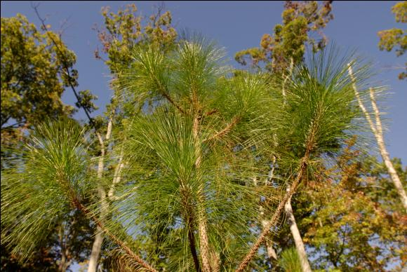
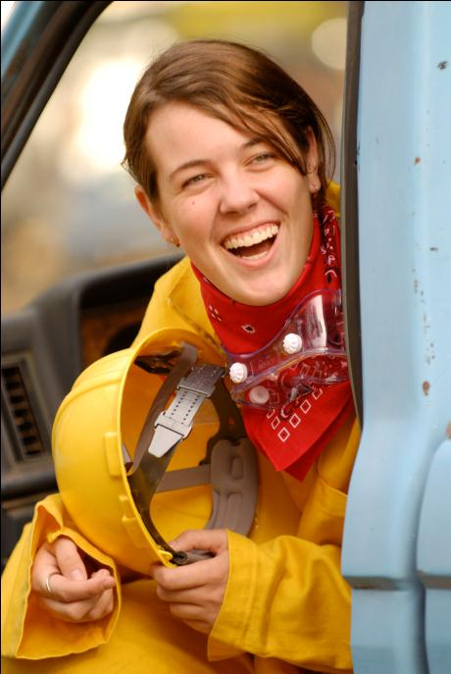
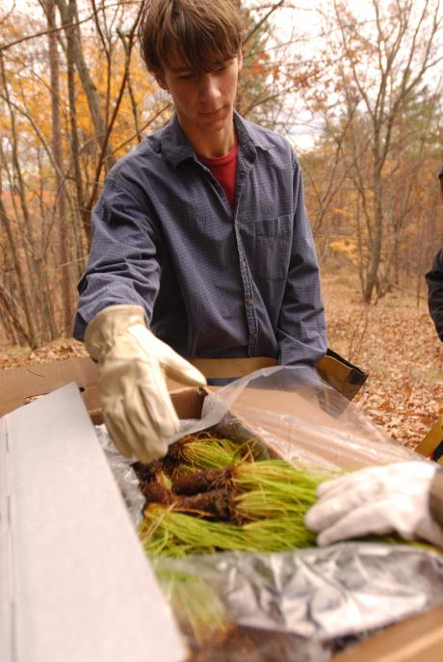
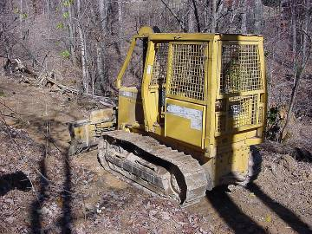
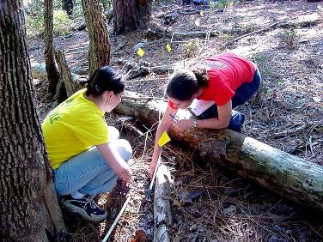
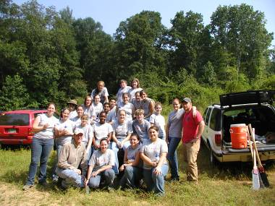
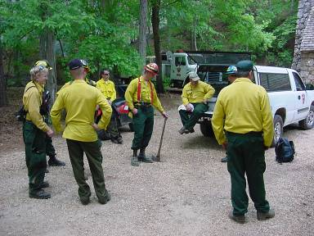

Slide 17
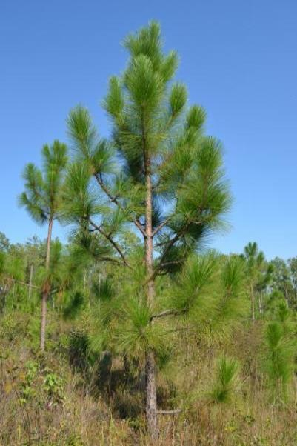
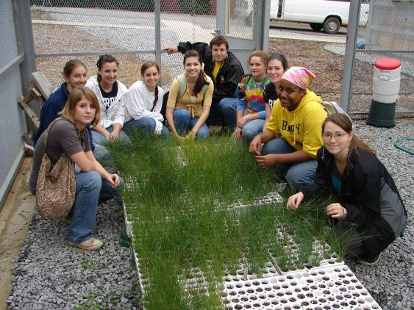
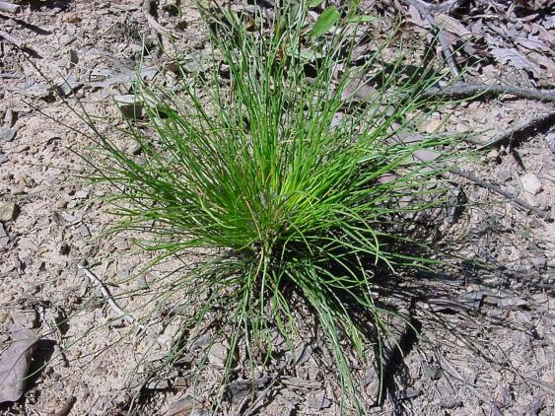
Management: Planting
Most planting done in SPB clear- and selective-cuts, followed by burning
Some in areas with hardwood canopy reduced via herbicide injection and burning
Focus is on low density “conservation” plantings.
Everybody loves to plant trees!

Slide 18
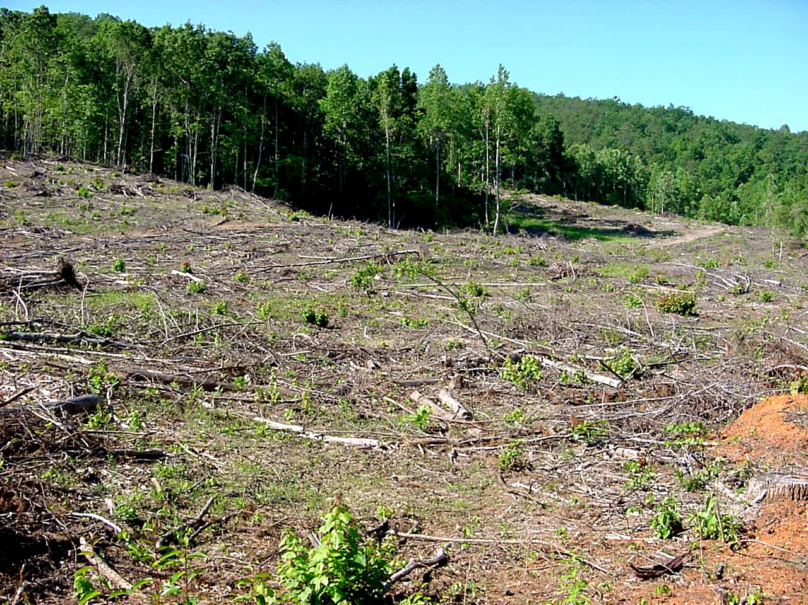

Slide 19
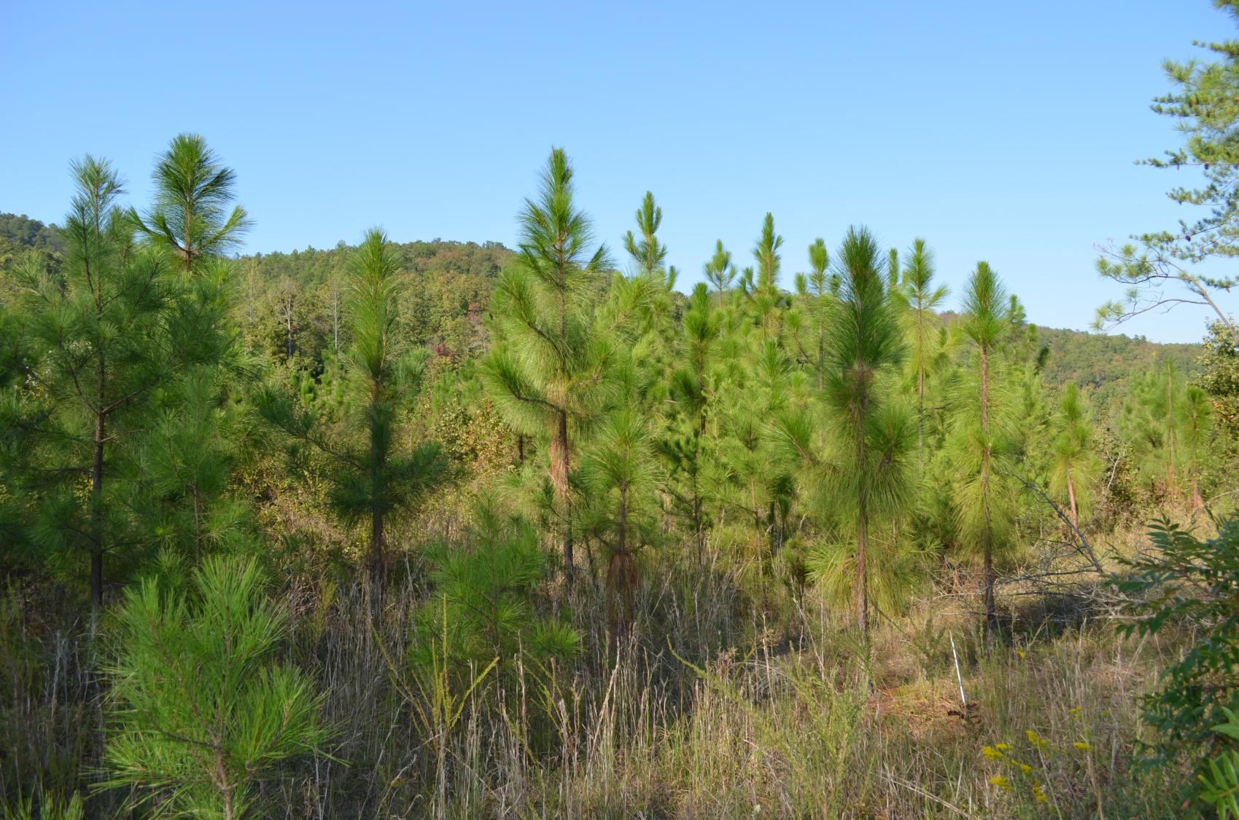

Slide 20
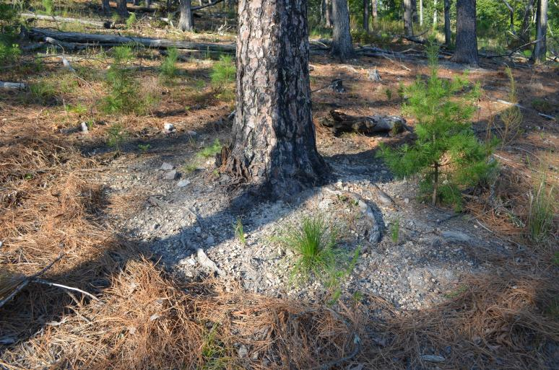
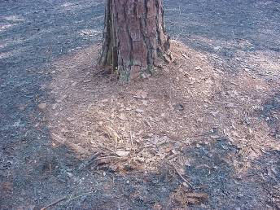
Management: Burning
Fuel reduction/restoration burns done in “old growth” areas – some areas burned four times since 2003
Raking around bases of old growth trees was necessary to control effects of duff smoldering.
Most planted areas have been burned at least twice since planting.

Slide 21
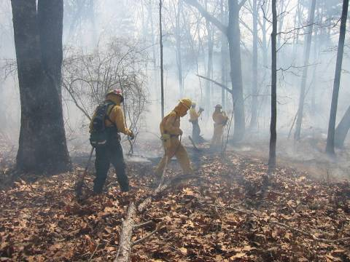
Management: Student Burn Team
Trained to meet USFS guidelines.
S130/S190 Fire Behavior and Safety
Southern Company/NFWF grant provided needed equipment

Slide 22
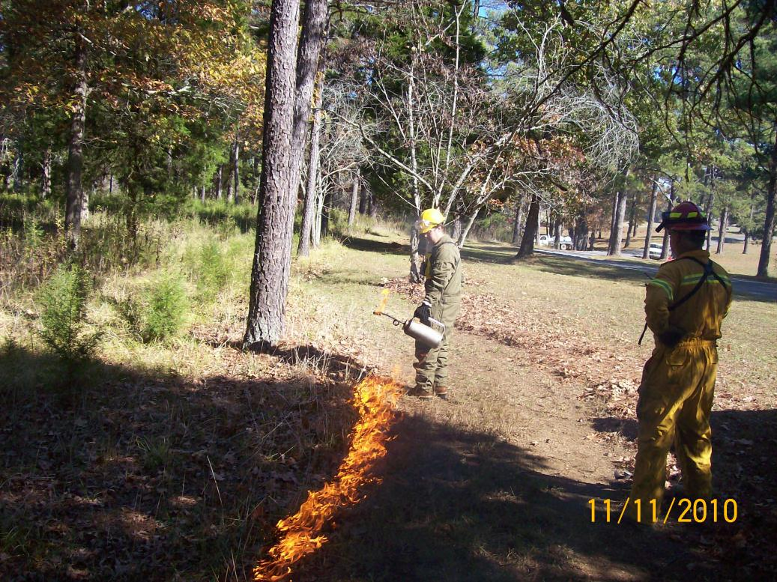
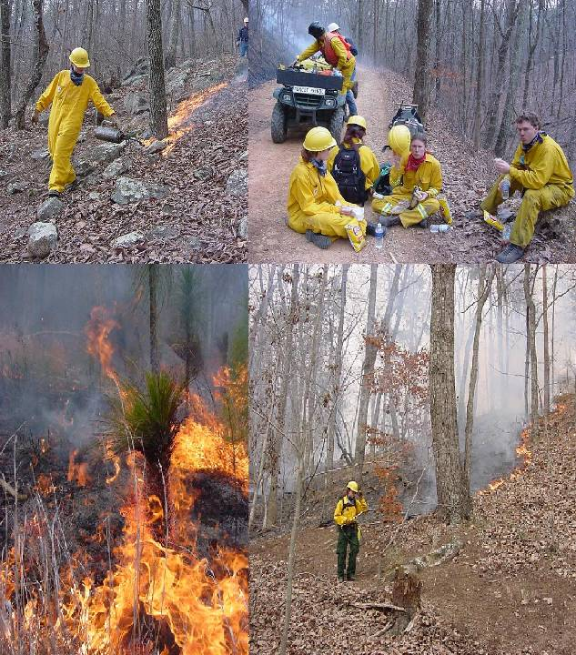
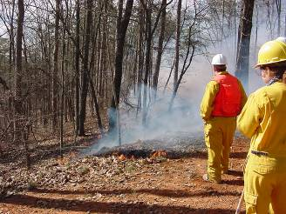

Slide 23
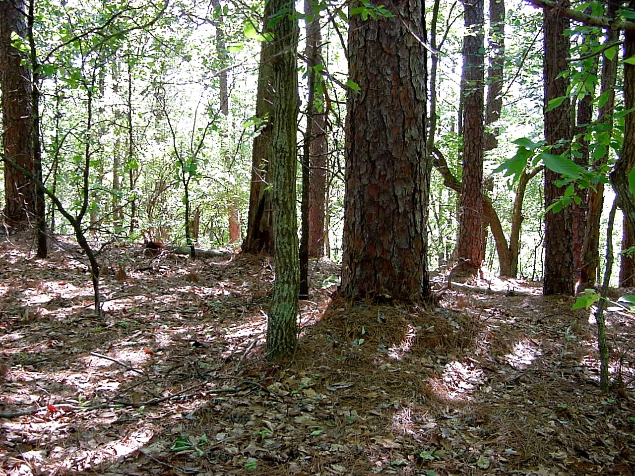

Slide 24
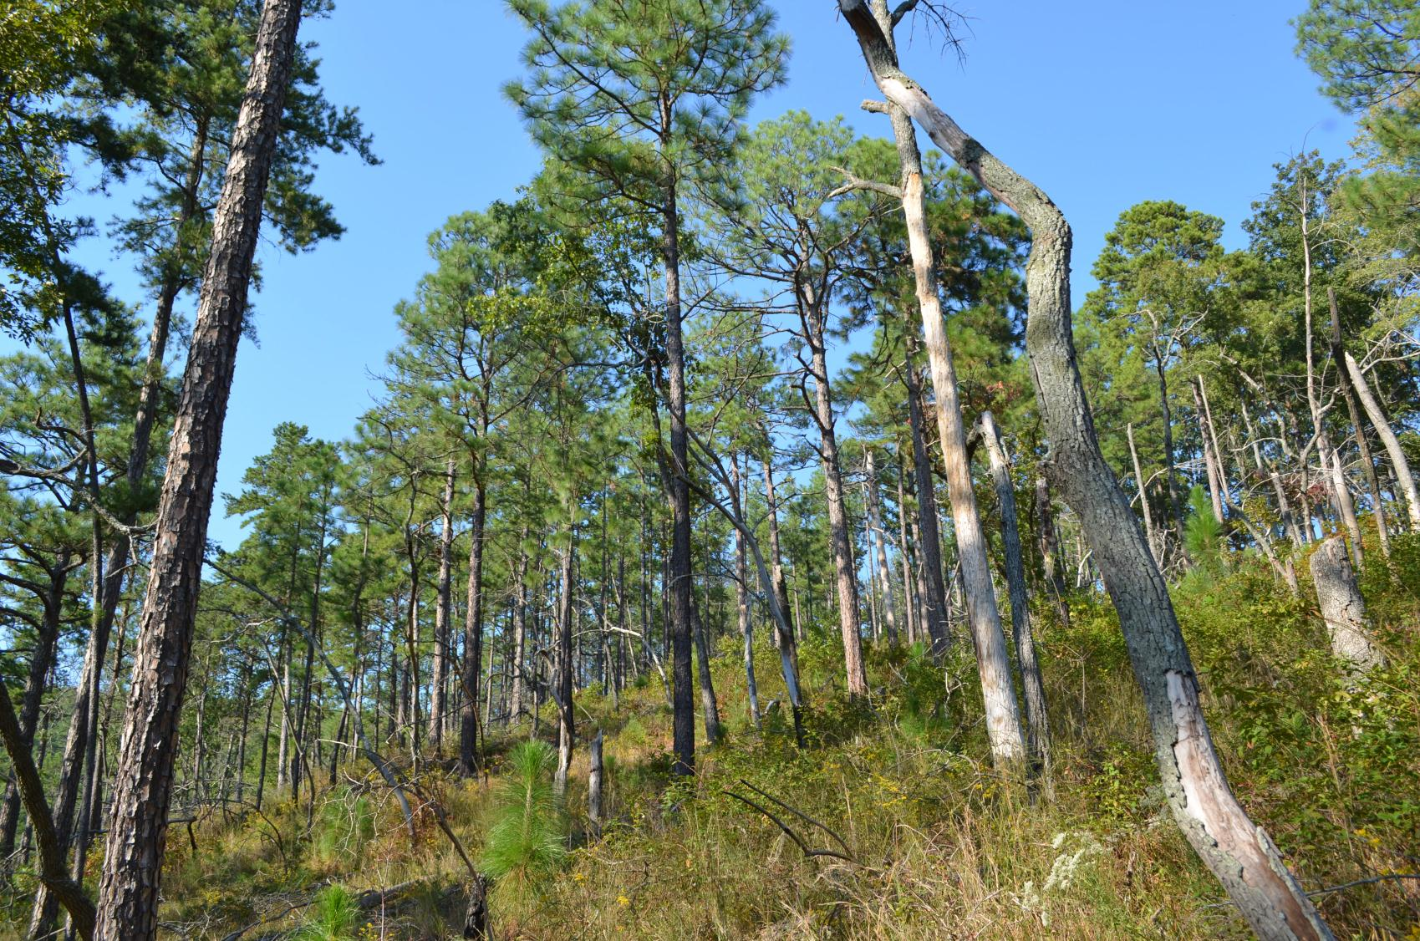

Slide 25
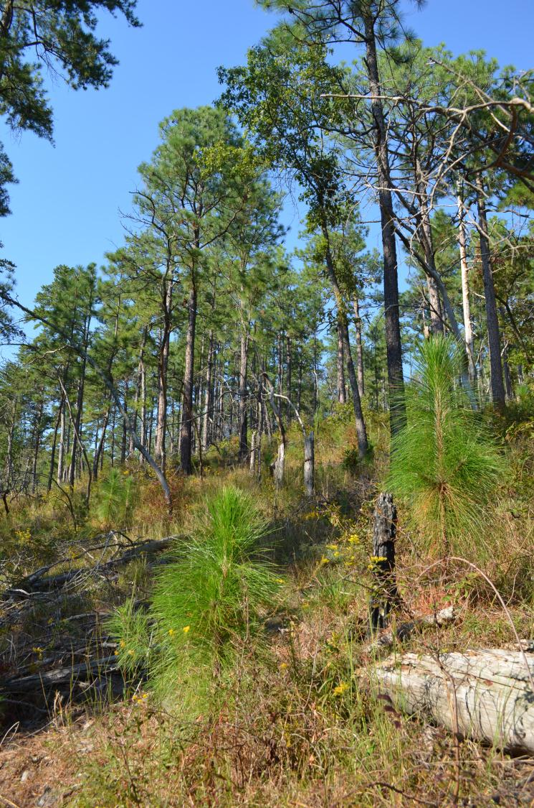
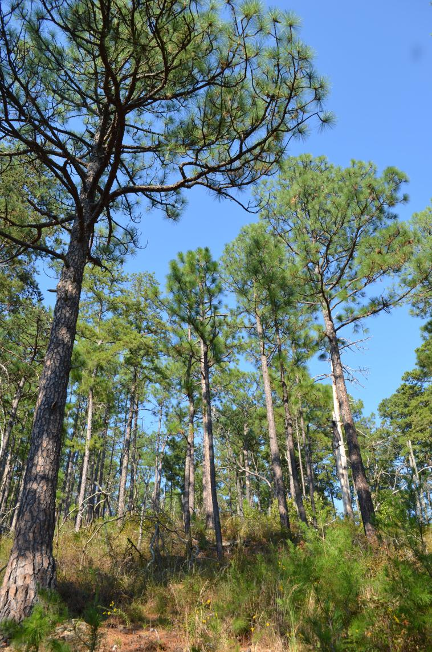

Slide 26
Management: Herbicides
Direct injection for hardwood control in core management area.
Directed spray for hardwoods and blackberry in SPB cuts.
Cut-stump and basal bark spray for hardwoods and shrubs in logged areas.

Slide 30
Management: Grafted seed orchard
Offsite source longleaf pine rootstock planted spring 2003.
Grafting work initiated winter 2005.
About 100 trees successfully grafted in 2.5 acre orchard; orchard now used in agroforestry project (sheep)
First cones in 2011.

Slide 32
Management: Seedling seed orchards
530 seedlings from 50 maternal trees grown in pots in 2007
Planted on a 4-acre clear cut in 2008 – 2009.
Early growth rates of individuals have been monitored.
Second orchard established in 2018 on 11 acres, over 1500 seedlings.

Slide 34
Research and Monitoring
Plant/Forest Ecology classes: Population dynamics, post-fire mortality, soil chemistry, changes in tree community over time
Berry Student Work program: Fuel loads, carbon storage, seedling survivorship, herbaceous plants and grasses, birds, reptiles and amphibians
External research (Univ. West GA, Georgia State, VA Tech, Clemson, etc.) fine root regeneration, soil nutrient dynamics, mycorrhizae, dendrochronology, forest structure
Berry NSF-REU Program: herbicides and prescribed burning effects, total carbon, herbaceous plants and grasses.

Slide 35
Key results in the first 10-12 years of management
Overall vegetative structure of mature stands “moving” in the direction of frequently-burned reference stands at the Mountain Longleaf Pine National Refuge and Talladega National Forest.
Herbaceous plants/grasses increased from 14 spp. (mostly shade-tolerant) to 130-170 spp. (mostly perennials with affinities for dry, sunny, acidic sites). List of characteristic “mountain longleaf” understory species developed by comparison with other sites.
Bird abundance increased about 50% in managed areas; community shifted from ground-feeding, canopy-nesting omnivores to foliage-feeding, ground- and shrub-nesting insectivores or seed/fruit-eaters.
Reptiles and amphibian diversity much higher in managed areas (15 species) vs. unmanaged areas (6 species); community has shifted toward species adapted to dry, sunny conditions.

Slide 36
Public Education and Outreach
Communications majors: helped develop PR plan and website.
GFC Healthy Forests grant: funded video, pamphlets, other PR
GA-DNR Interpretive Trails grant: funded Longleaf Trail
Dozens of service/learning experiences have involved 100s of primary- and secondary-school students, Berry College students, and members of the general public.

Slide 37
Public Education and Outreach

Slide 38
For more information:
www.berrylongleaf.com

